Slide 1




My Algebra Interactive Notebook
$$3ab$$
$$2x+3y$$
$$\frac{5xy}{6}$$
Name :
Class :
Term 2 Semester 1
$$y=2x+1$$

Slide 2
Intro Activity
Fraction of the Day handout – work on it in pairs for 5 minutes, doing as much as you can.
After 5 minutes, find another group of two and swap with them; you check their work and they check yours
Notes:
After 2 minutes is up, have students call out what they know, popcorn-style and write on the board.

Slide 3
24
7
30
Date
Terminating and Recurring Decimals
EQ – What are terminating and recurring decimals and how do we represent them mathematically?
Summary:

Slide 4
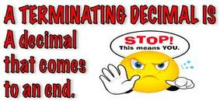
24
7
30
Date
Terminating and Recurring Decimals
EQ – What are terminating and recurring decimals and how do we represent them mathematically?
What are Terminating Decimals?
The division of two numbers can lead to whole numbers, or more often, decimals:
A terminating decimal is a decimal that stops, or terminates
Some examples are:
18/5=3.6
88/200=0.44

Slide 5
24
7
30
Date
Terminating and Recurring Decimals
EQ – What are terminating and recurring decimals and how do we represent them mathematically?
What are recurring decimals?
A recurring decimal is a decimal with an infinite number of digits, or group of digits (they will continue forever)
1/3 = 0.333333333333333…
4/15= 0.2666666666666666…
11/7= 1.571428571…

Slide 6
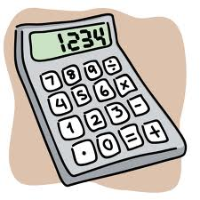
Your turn – convert the following to decimals.
Also decide whether they are terminating or recurring
12/7
5/16
1/3
100/8
(YOU CAN USE YOUR CALCULATOR)

Slide 7
Answers
12/7 = 1.714285714 RECURRING
5/16 = 0.3125 TERMINATING
1/3= 0.3333333… RECURRING
100/8= 12.5 TERMINATING

Slide 8
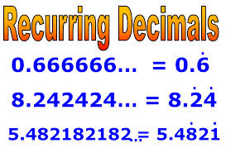

24
7
30
Date
Terminating and Recurring Decimals
EQ – What are terminating and recurring decimals and how do we represent them mathematically?
How do we write recurring decimals?
Write any non-recurring digits, then the digits that form the repeating pattern
Place a dot on top of the first and last digits of the repeating pattern, or draw a line above them
This is called writing the decimal in EXACT FORM

Slide 9
Your Try – write as an exact decimal
1/7
1/13
1/12
1/11
4/7
(YOU CAN USE YOUR CALCULATOR)

Slide 10

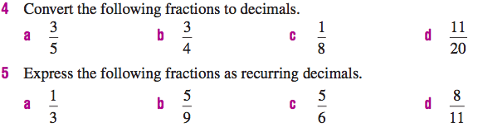


Your turn

Slide 11
24
7
30
Date
Terminating and Recurring Decimals
EQ – What are terminating and recurring decimals and how do we represent them mathematically?
Summary:
Your turn to answer the EQ!

Slide 12
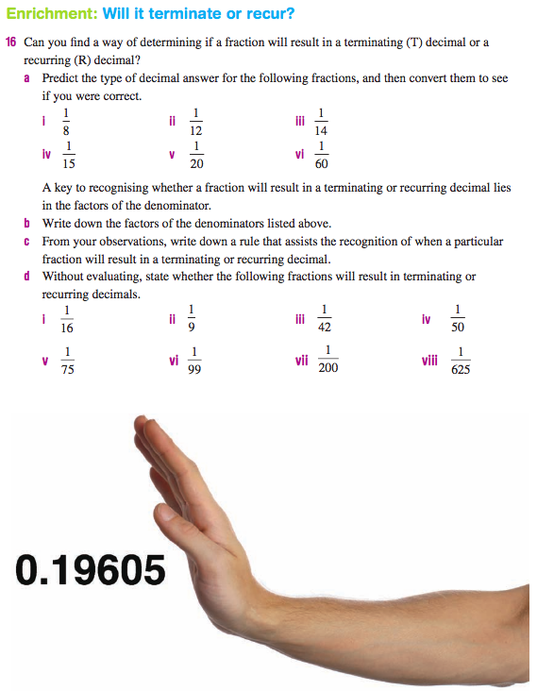

Slide 13
Notes Review
24, 7 ,30
Date
Title
Essential question
Notes complete
Notes complete with colour and diagrams
Questions completed
Contents page filled in
Formula page filled in

Slide 14
Homework
Review your notes and write a summary answering the essential question.

